Slide 1

CYBERBULLYING DETECTION ON SOCIAL MEDIA
ADIKAVI NANNAYA UNIVERSITY
DEPARTMENT OF COMPUTER SCIENCE AND ENGINEERING
Under the guidance of
Mr. K V V RAMANA ,
Assistant Professor (Ad-hoc)
University College of Engineering
Presented by
B.Surendra
198297601066

Slide 2
Cyberbullying Detection on social media by using Machine Learning

Slide 3
Contents
Abstract
Introduction
Existing System
Proposed System
Uml Diagrams
Implementation
Output Screenshots

Slide 4
Abstract
Bullying has been prevalent since the beginning of time, It’s just the ways of bullying which have changed over the years, from physical bullying to cyberbullying. According to Williard(2004), there are eight types of cyberbullying such as harassment, denigration, impersonation, etc. It’s been around 2 decades since social media sites came into the picture, but there hasn’t been a lot of effective measures to curb social bullying and it has become one of the alarming issues in recent times. Aim is to establish for this task by applying supervised classification methods using a manually an noted open source dataset.

Slide 5
Introduction
With the growth of social media platforms, cyberbullying is a significant concern among the younger population. Cyberbullying can have adverse effects on vulnerable people and is considered a severe threat.
Therefore, the presence of an active cyberbullying detection system is crucial. In this project we experiment with various classifiers to get achieve a higher accuracy in the cyberbullying dataset , while using traditional ML models rather than Deep learning models.

Slide 6
Existing System
Using the traditional supervised learning methods
Naive Bayes: This is a simple probabilistic classifier that has been widely used for text classification tasks, including cyberbullying detection. Naive Bayes models can effectively capture the relevant features of a tweet and classify it as bullying or not bullying.
But the results are minimal using the traditional supervised learning methods like Naïve Bayes

Slide 7
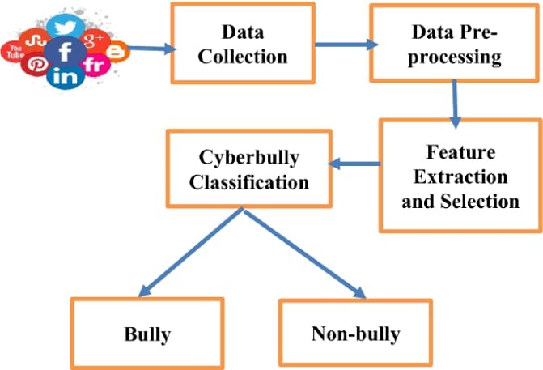
Proposed System
INVOLVES:
Data collection
Data pre-processing
Model training
Model evaluation
Results
In this proposed system we experiment various Supervised algorithms, including standard, as well as ensemble methods.

Slide 8
Data collection: Collect a large dataset of text data that contains instances of cyberbullying, as well as instances of non-cyberbullying text (i.e. "normal" online communication).
Data pre-processing: Clean and pre-process the collected data, such as removing stop words, stemming/lemmatizing words, and removing special characters. Feature extraction: Extract relevant features from the pre-processed data, such as the presence of certain words or phrases, or the use of certain emoticons.
Model training: Train a supervised classification model, such as a support vector machine or a random forest, using the extracted features and labelled training data.
Model evaluation: Evaluate the performance of the trained model using a held-out test dataset, and iteratively improve the model by adjusting the features or model parameters.
Results: Once the model has been trained and evaluated, it can be deployed to detect cyberbullying in real-world text data.

Slide 9
UML Diagrams

Slide 10
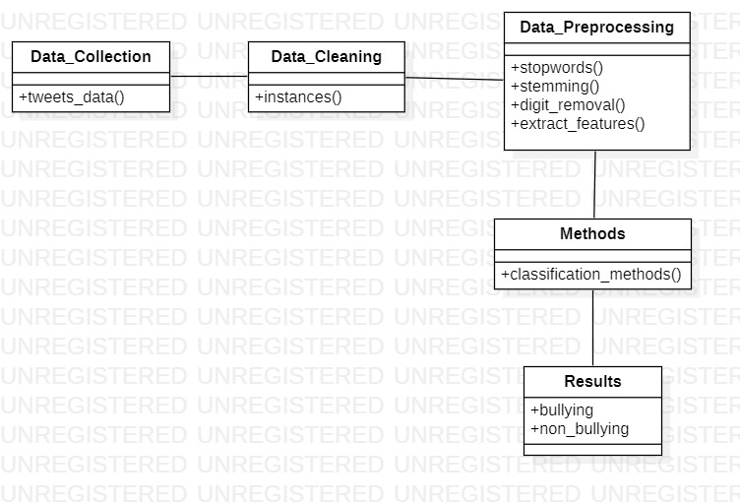
Class Diagram

Slide 11
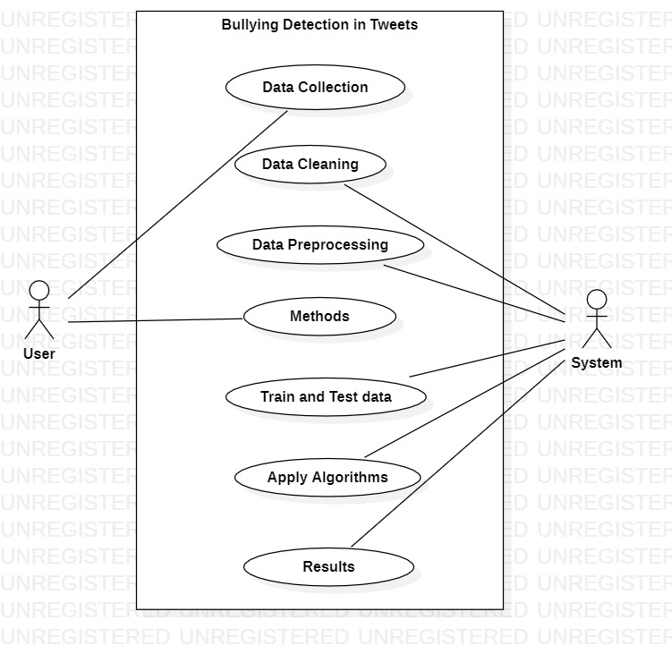
Use Case Diagram

Slide 12
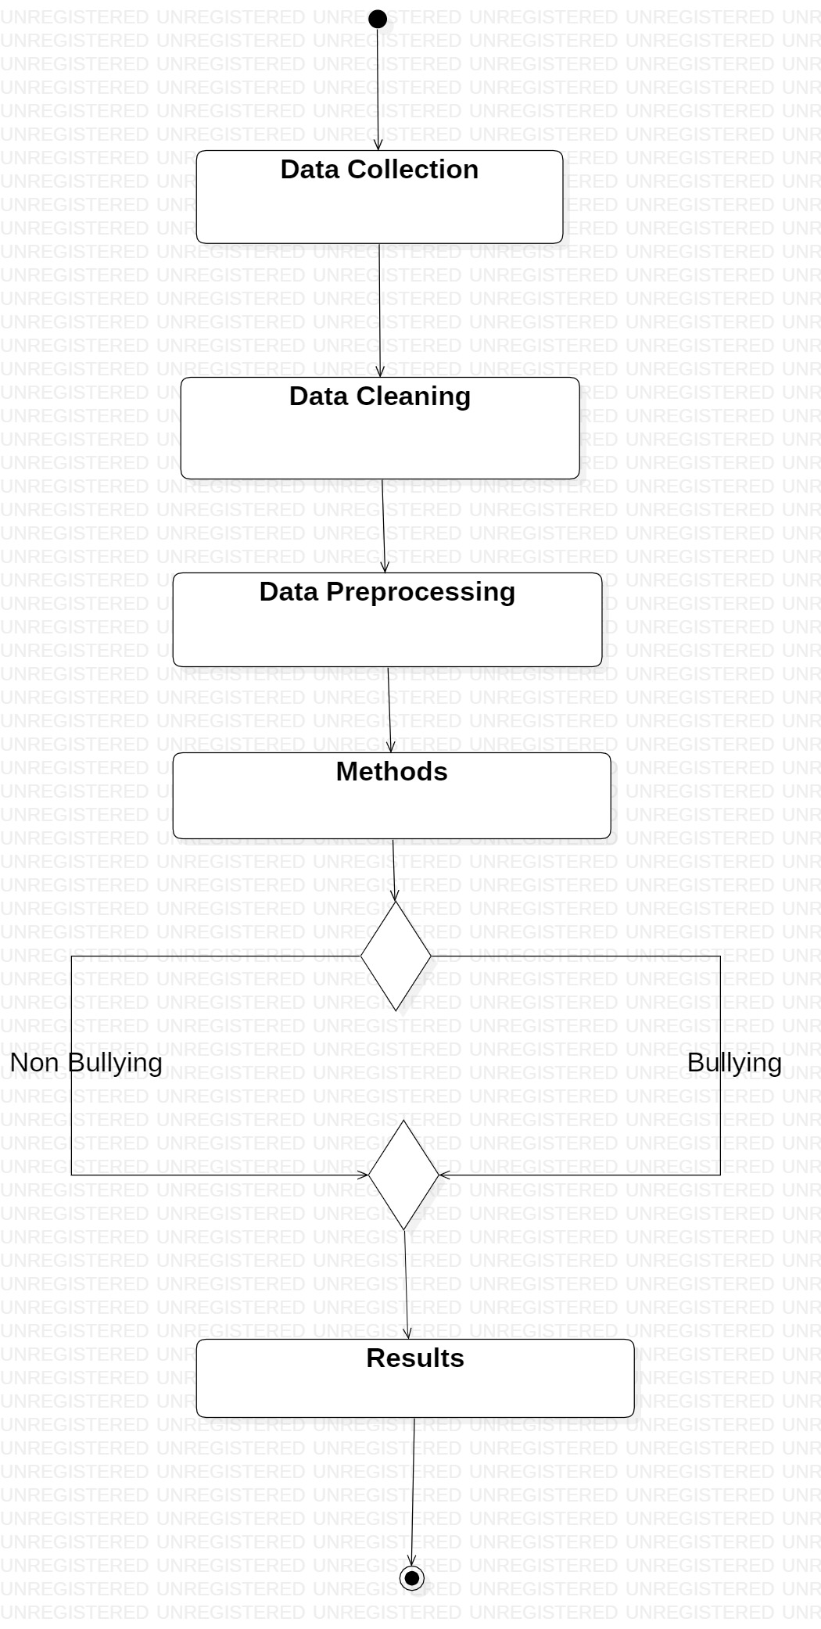

Activity Diagram
no
yes
Decision node

Slide 13
Implementation

Slide 14
Dataset
Tweet Dataset for Cybertroll Detection obtained from Kaggle
The dataset has 2 attributes- tweet and label
[0 corresponds to No while 1 corresponds to Yes]
Here is the Detailed Description of the dataset:
1) It is a partially manually labelled dataset.
2) Total Instances: 20001

Slide 15
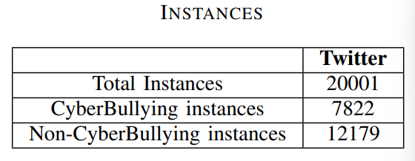
The dataset used was set in a json format. Since the fields of the dataset were relatively simple to interpret, the original set of fields in the annotation attribute was removed, and filled with the label values to simplify the next step. The number of instances for each class are mentioned in table

Slide 16
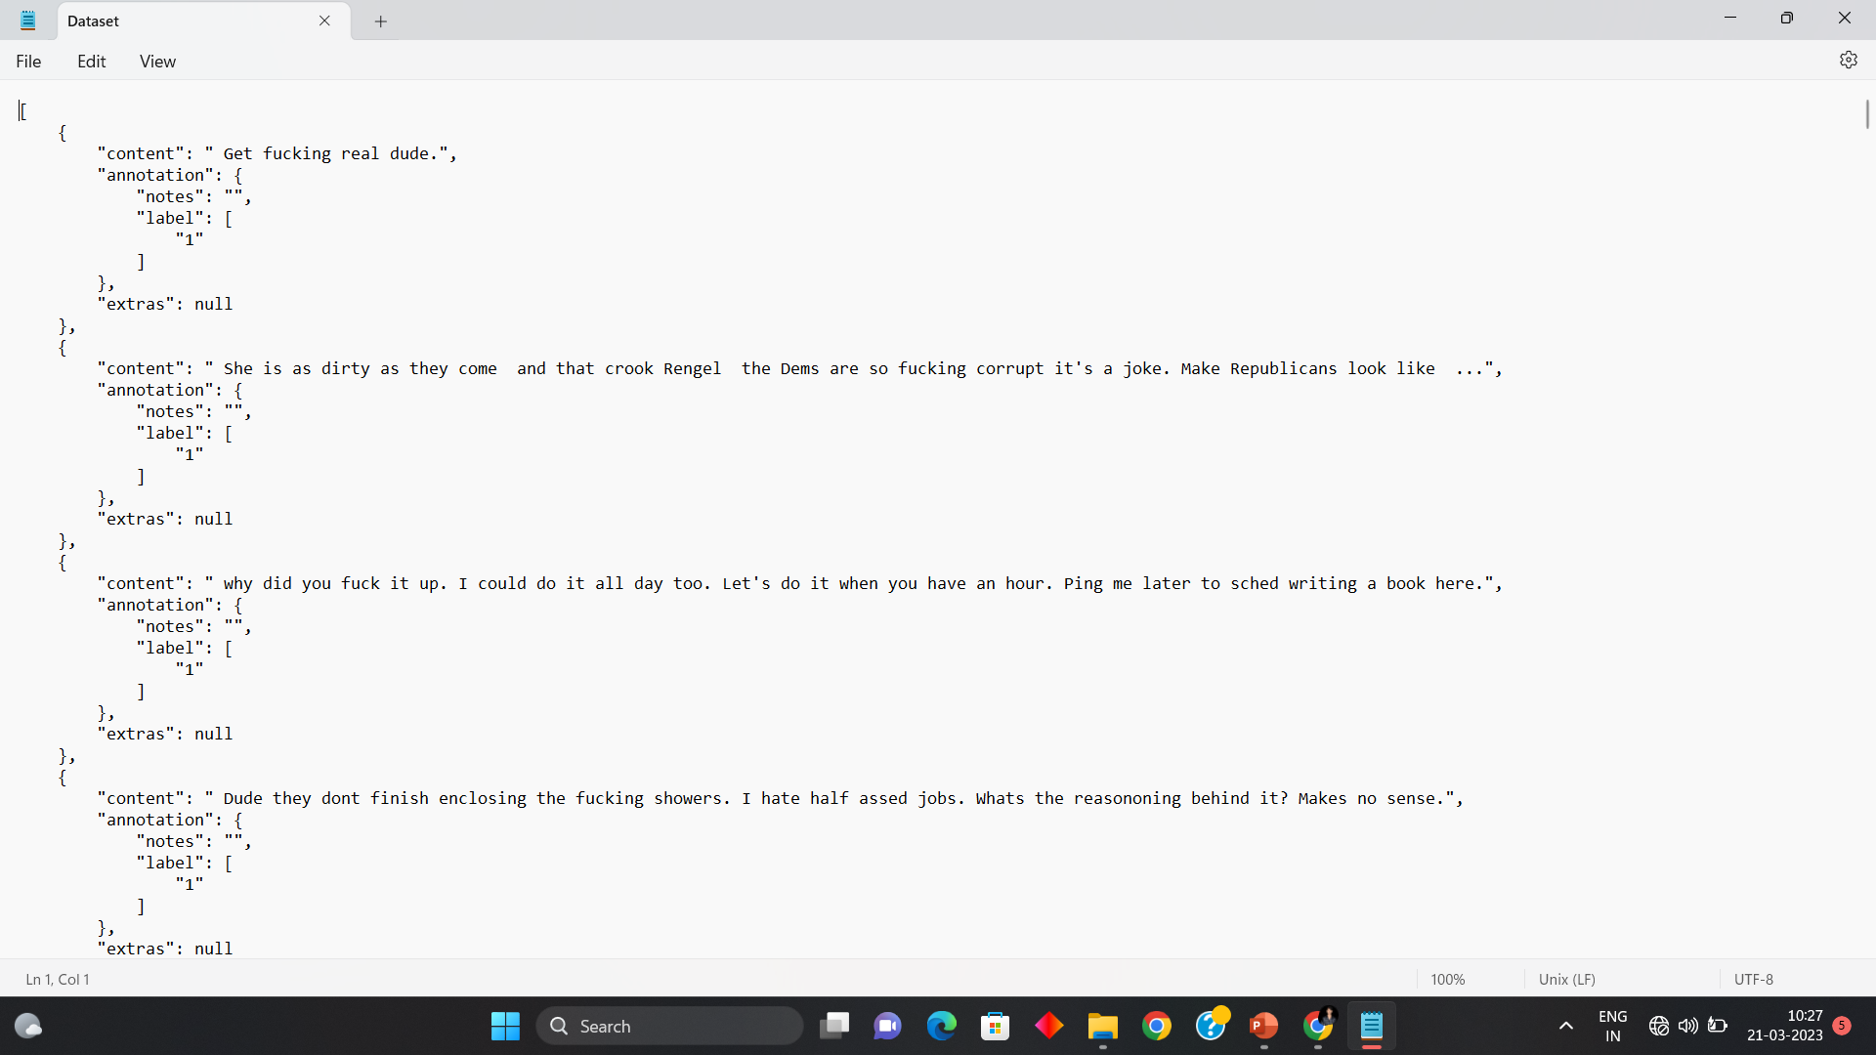

Slide 17
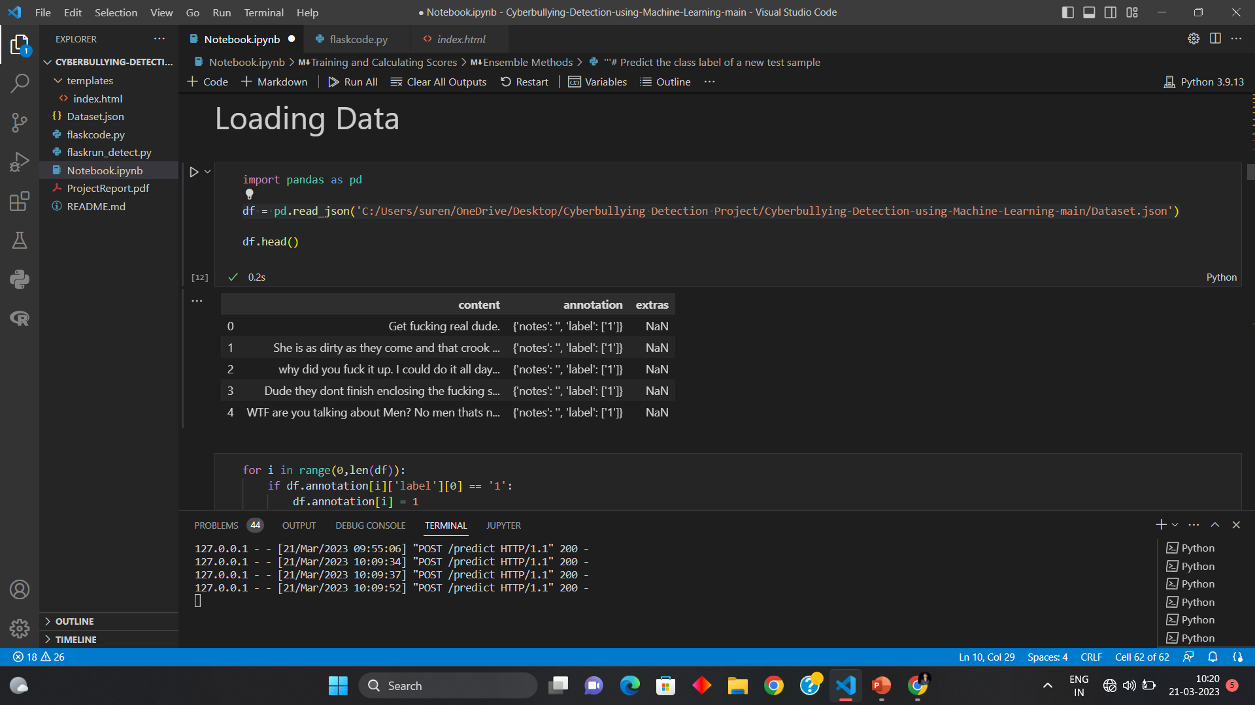

Slide 18
Data Pre-processing
Stop words filtering is done using nltk.corpus.stopwords.words(‘english’) to fetch a list of stopwords in the English dictionary, after which they are removed. Stop words are words such as “the”, “a”, “an”, “in”, which are not significant and do not affect the meaning of the data to be interpreted
Stemming: Stemming is a process of linguistic normalization, which reduces words to their word root word. We stem the tokens using nltk.stem.porter.PorterStemmer to get the stemmed tokens. For example, connection, connected, connecting word reduce to a common word ”connect”
Digit removal: We also filtered out any numeric content as it doesn’t contribute to cyberbullying.

Slide 19
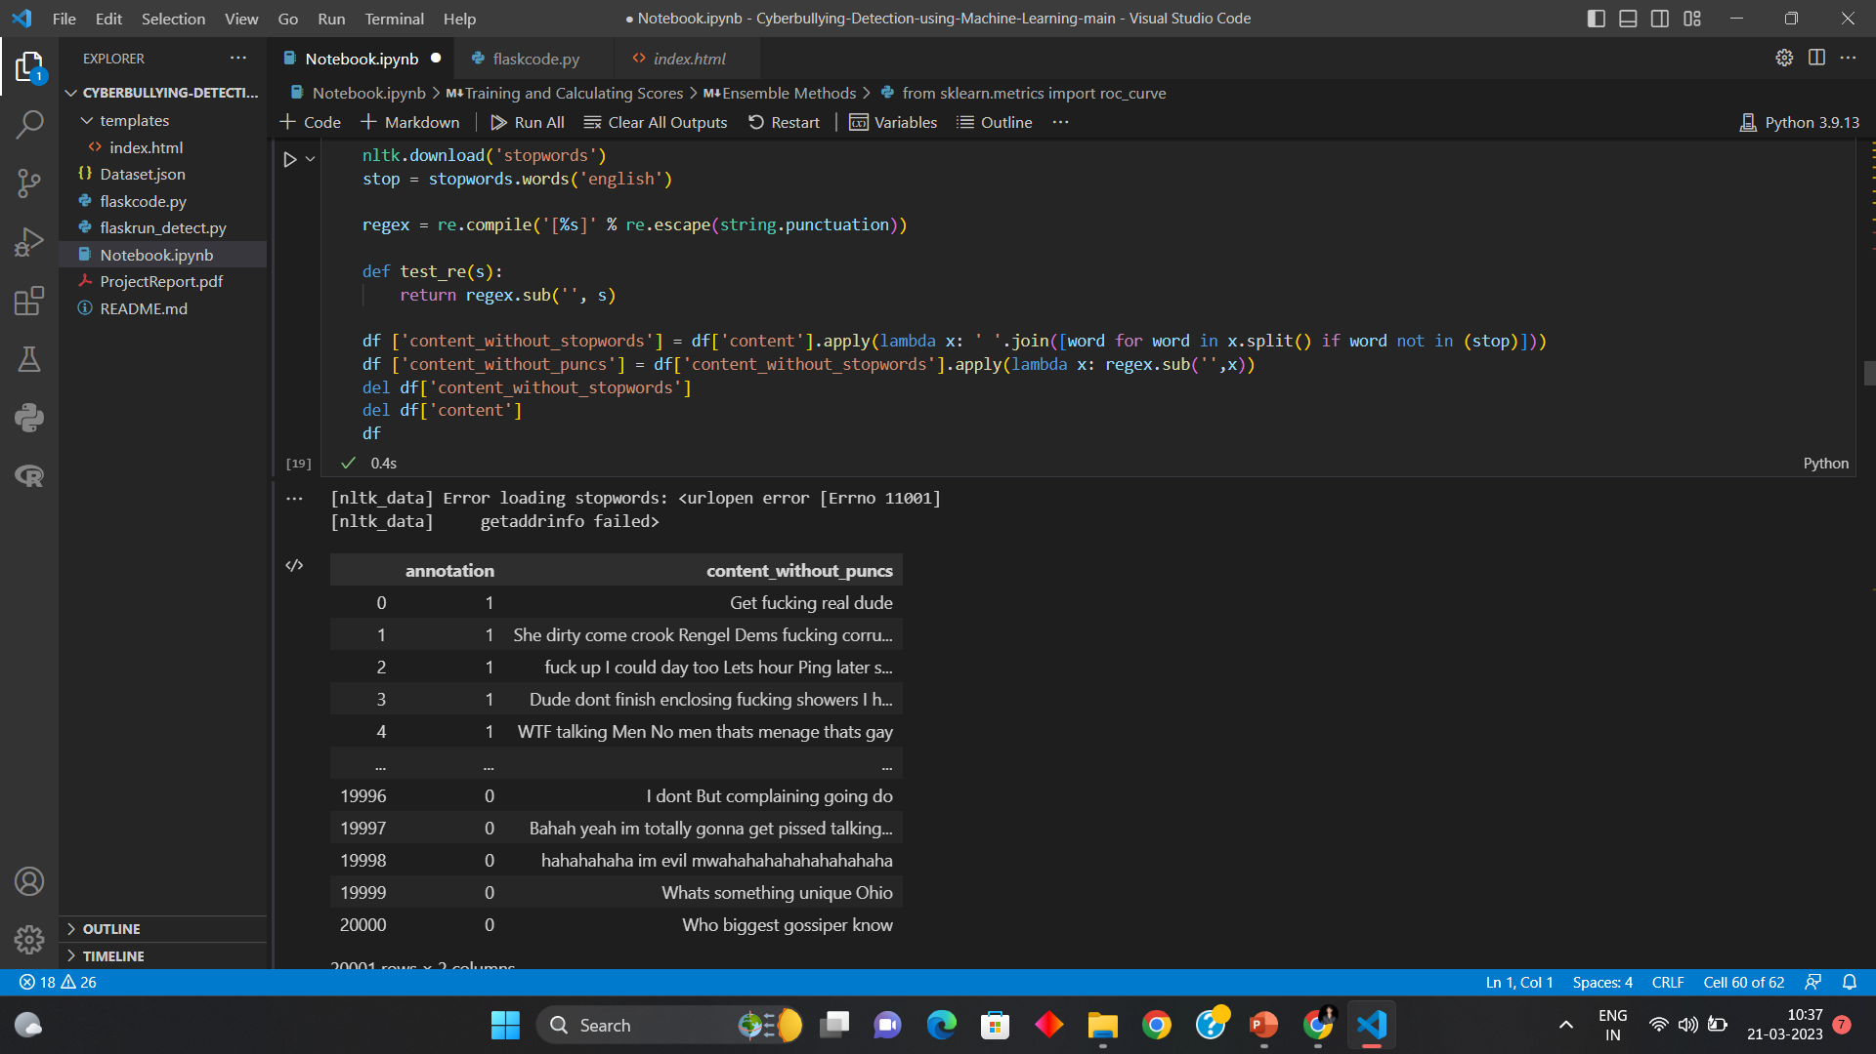
Stopwords

Slide 20
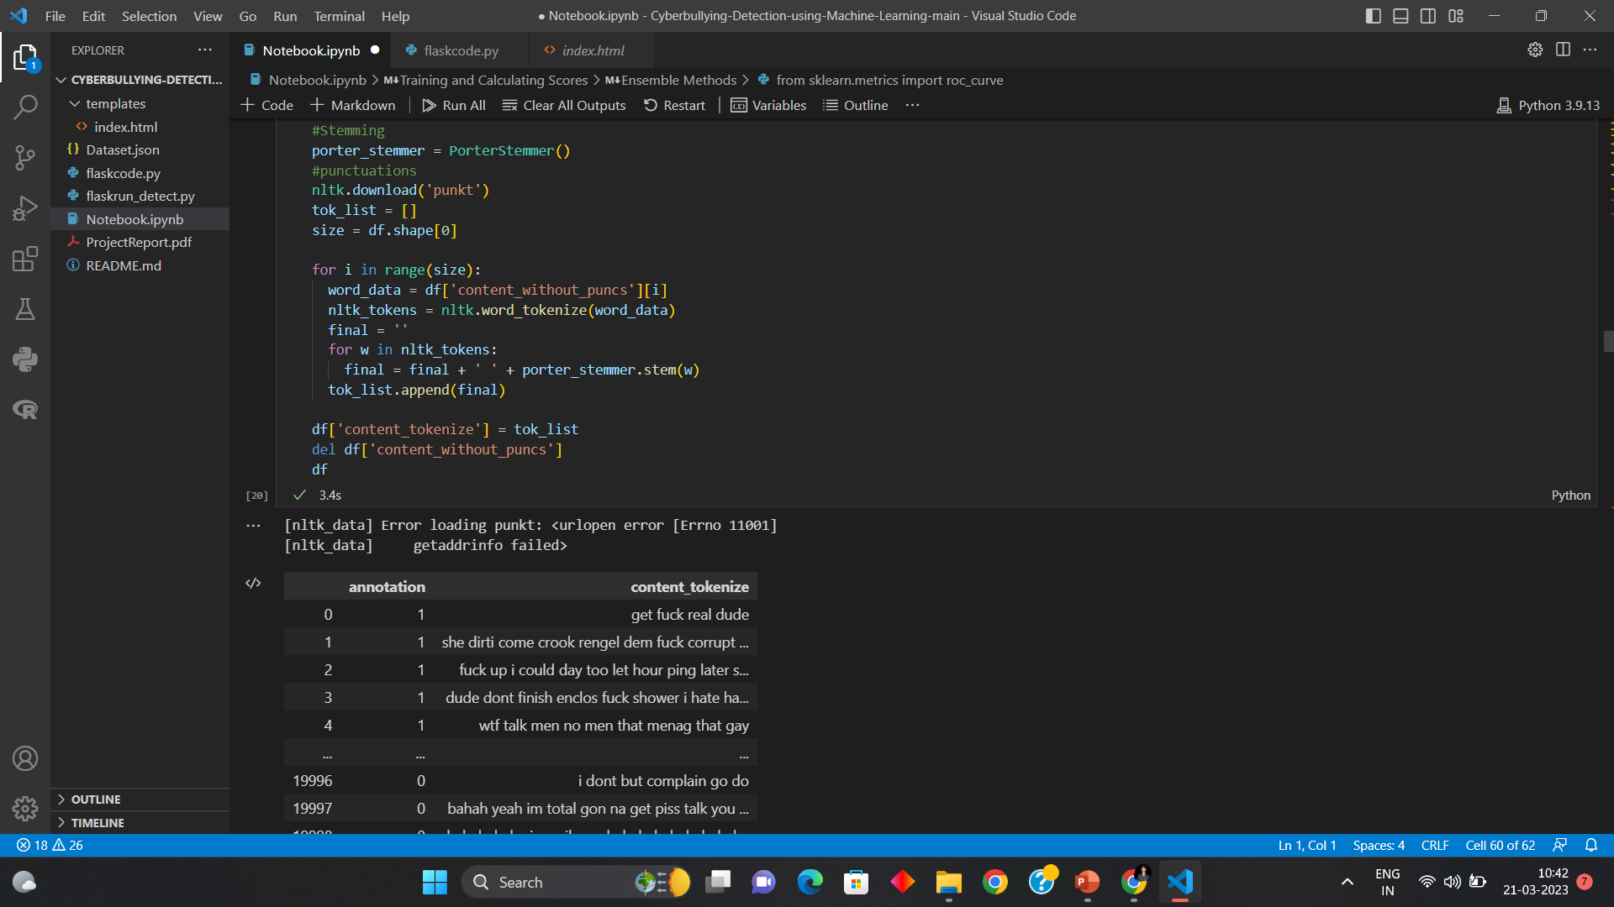
Stemming

Slide 21
Methods used
Supervised Learning Methods
Gaussian Naive Bayes: Naive Bayes classifiers are a collection of classification algorithms based on Bayes’ Theorem of mathematics. In simple words, the Bayes’ theorem describes the probability of an event, based on prior knowledge of conditions that might be related to the event
Logistic Regression: Regression analysis is a predictive modelling technique that analyzes the relation between the target or dependent variable and independent variable in a dataset.

Slide 22
Decision Tree Classifier: A Decision Tree is constructed by asking a series of questions with respect to the dataset. Each time an answer is received, a follow-up question is asked until a conclusion about the class label of the record. The series of questions and their possible answers can be organised in the form of a decision tree, which is a hierarchical structure consisting of nodes and directed edges. It has 3 types of nodes: Root, Internal, and Leaf nodes.

Slide 23
Ensemble Methods
Adaboost Classifier: AdaBoost is an iterative ensemble method. The general idea behind boosting methods is to train predictors sequentially, each trying to correct its predecessor. AdaBoost classifier builds a strong classifier by combining multiple poorly performing classifiers
Random Forest Classifier: As its name implies, Random Forest Classifier consists of a large number of individual decision trees that operate as an ensemble. Each individual tree in the random forest spits out a class prediction and the class with the most votes becomes our model’s prediction.

Slide 24
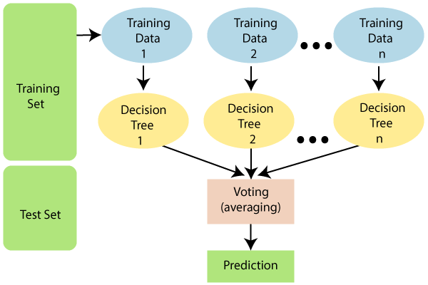

Slide 25
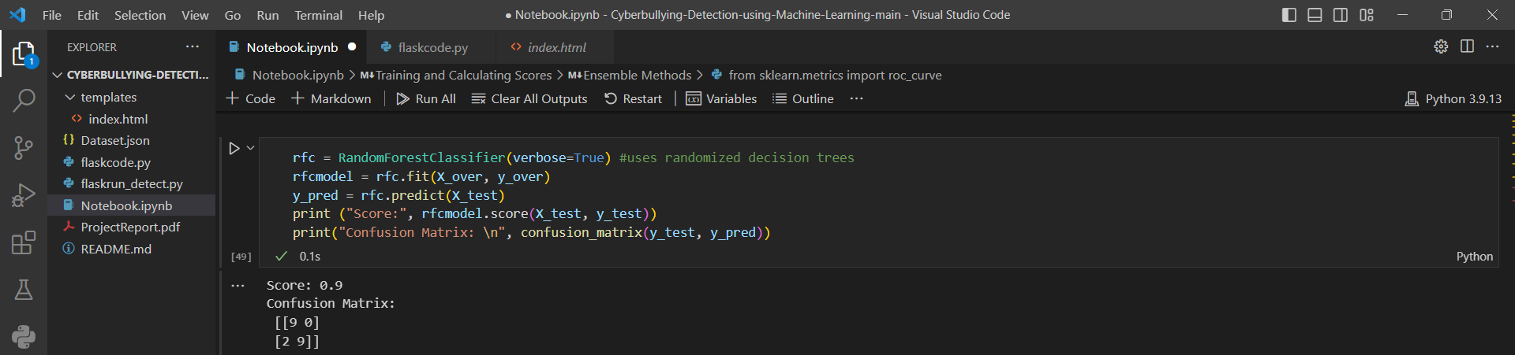
Result
For the supervised learning technique analysis, I’ve used Naive Bayes(Gaussian), Logistic regression, and Decision Tree as the standard methods
As Ensemble methods, I have used AdaBoost and Random Forest Classifiers
Found that the Gaussian Naive Bayes classifier performed the poorest, whereas the Random Forest Classifier gave the best result

Slide 26
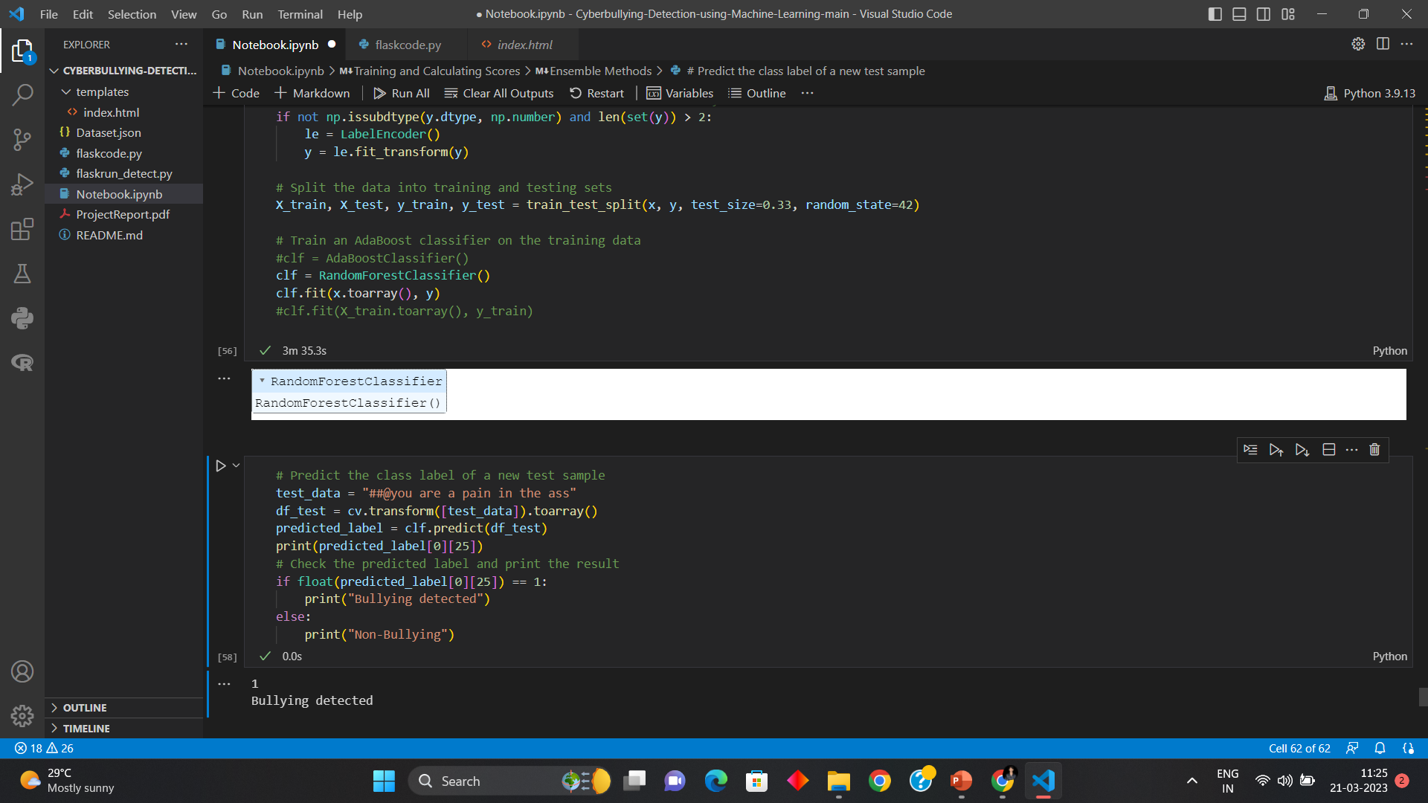

Slide 27
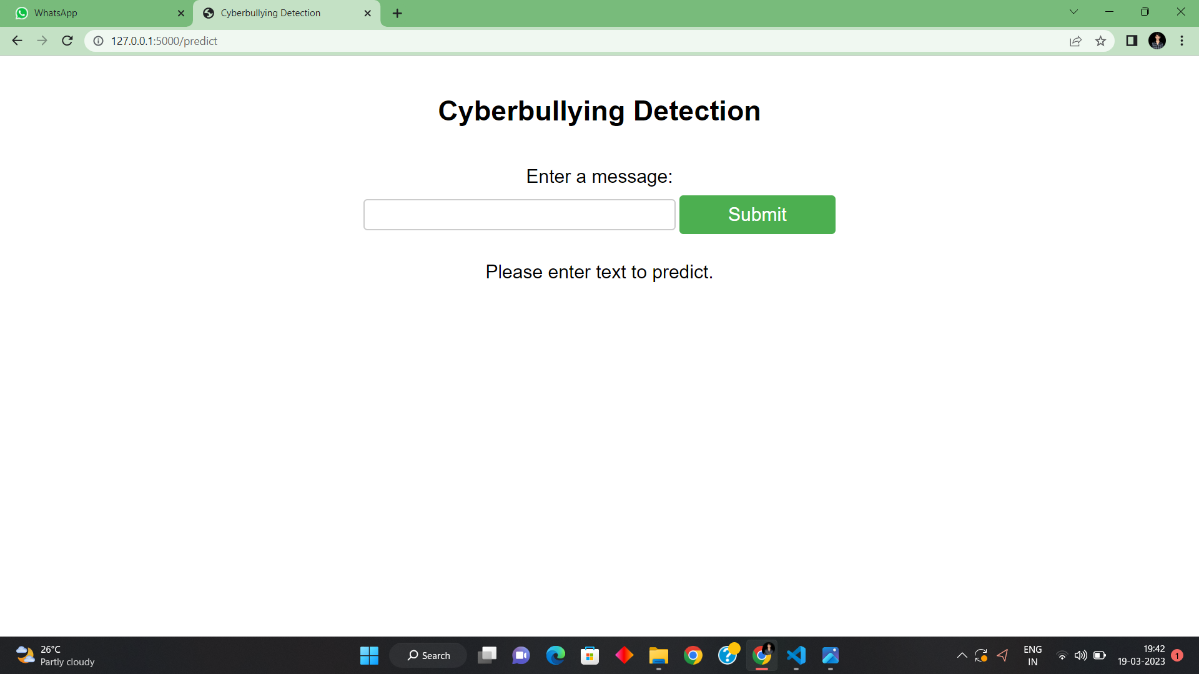
Output Screenshots

Slide 28
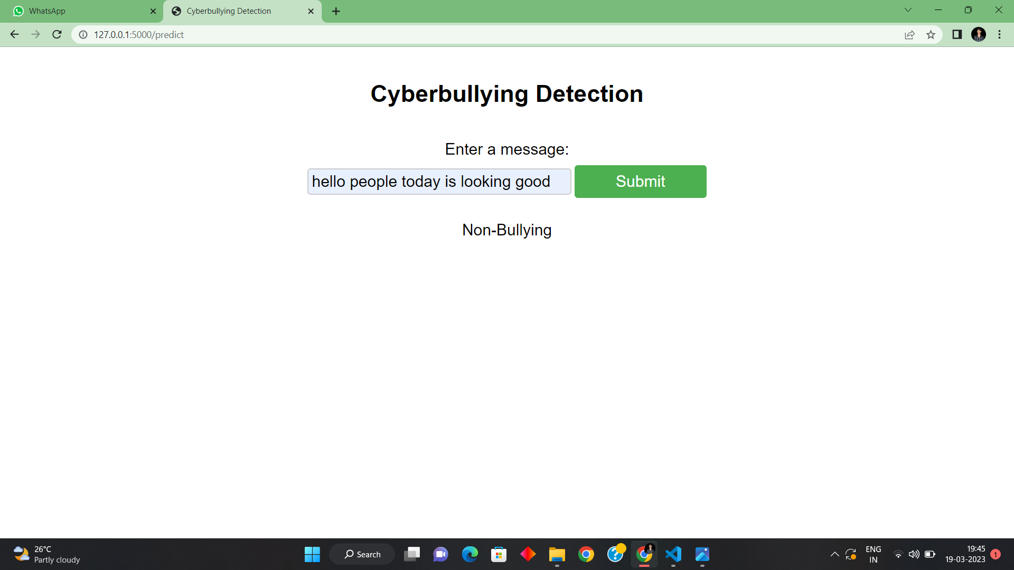

Slide 29
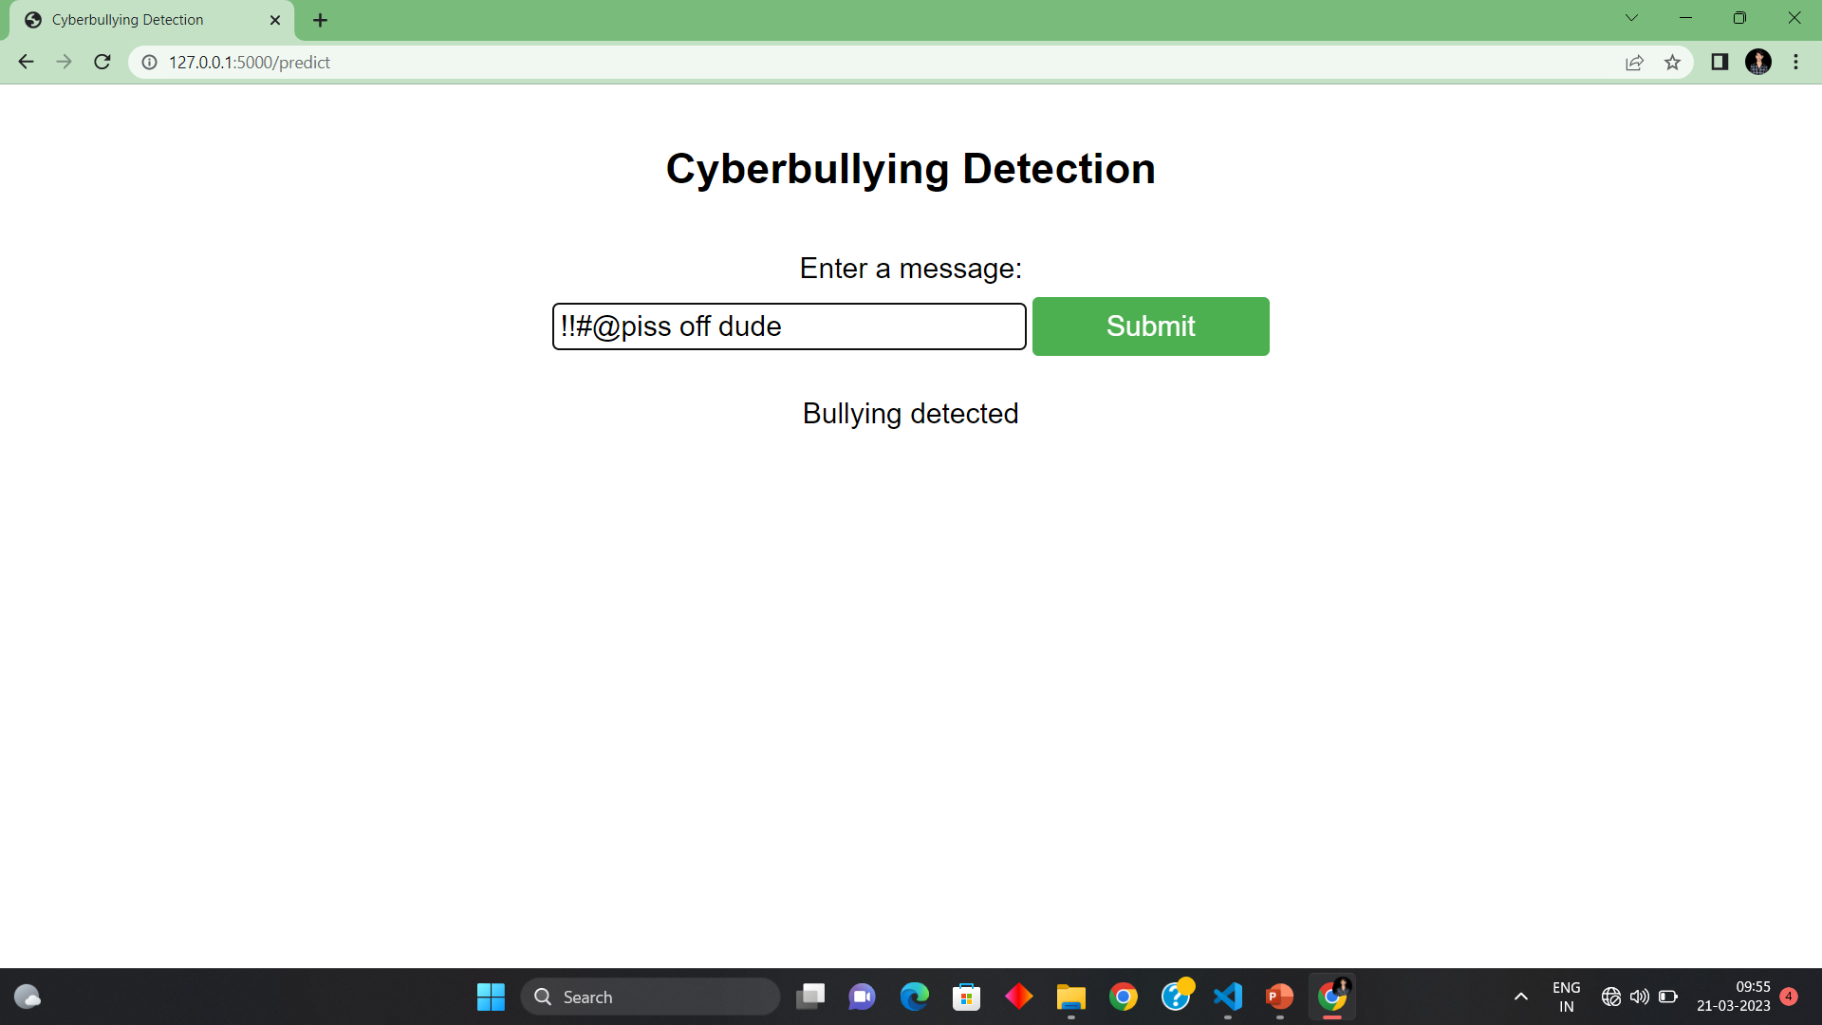

Slide 30
Thank you

